Slide 1

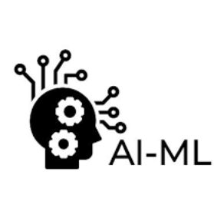
π
numpy,pandas,sklearn
June 2024
π

Slide 2
π
AI ML
In AI+ML all the data is represented in numeric format
Array
Vector
Even image is also represented in numeric format

Slide 3
π
Numpy
Numpy is used to perform fast mathematical operation
Numpy
pandas is built on top of numpy and it makes data manipulation easy.
if we have lots of messy data, we can eaisly clean filter and organize it
Once data is ready
Sci kit learn
we run algorithm for task like regression ,classficiation.all of these provided by sci-kit learn .
we can say that it is a machine learning tool kit
Notes:
Content: https://www.linkedin.com/pulse/chunking-strategies-ai-data-kash-kashyap-0lghe/

Slide 4
π
Matplotlib
It is python library and used for data visualization
Notes:
Content: https://www.linkedin.com/pulse/chunking-strategies-ai-data-kash-kashyap-0lghe/

Slide 5
π
Notes:
Content: https://www.linkedin.com/pulse/chunking-strategies-ai-data-kash-kashyap-0lghe/

